Slide 1
AWP&B 2018-19 MID-DAY MEAL SCHEME mizoram

Slide 2
performance during 2017 - 2018

Slide 3
School Coverage
Existing School |  |  | Coverage during 2017-18
PS | UPS | Total | PS | UPS | Total
1441 | 1091 | 2532 | 100% | 100% | 100%

Slide 4
Students coverage
Enrolment achieved during 2017-18 |  |  | Average Covered during 2017-18
PS | UPS | Total | PS | UPS | Total
1,00,061 | 44,889 | 1,44,950 | 92% | 92% | 92%

Slide 5
Engagement of Cook-cum Helper
PAB Approval 2017-18 |  |  | Actual engaged during 2017-18
PS | MS | Total | PS | MS | Total
3061 | 2159 | 5220 | 2897 (95%) | 2101 (97%) | 4998 (96%)

Slide 6
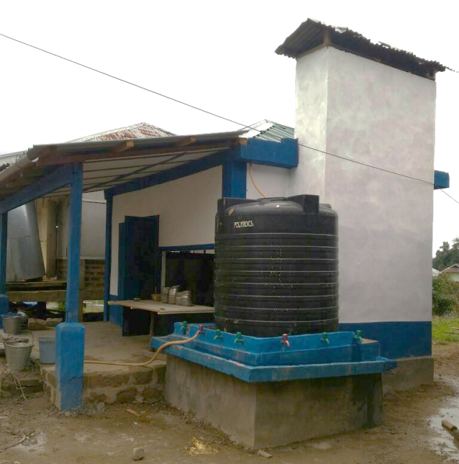
Completion of Construction of Kitchen-cum-Store
Construction of 110 Kitchen-cum-Stores sanctioned during 2016-17 were completed during 2017-18.

Slide 7
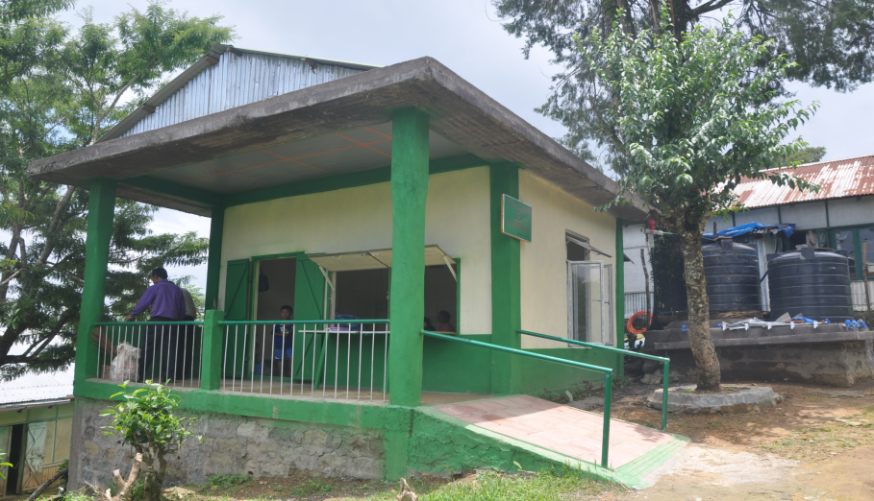
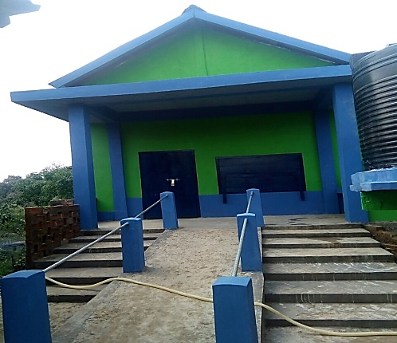
Completion of Construction of Kitchen-cum-Store

Slide 8
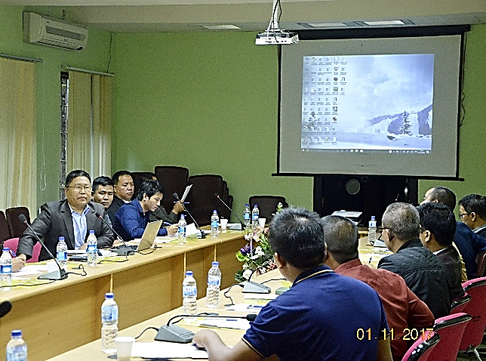
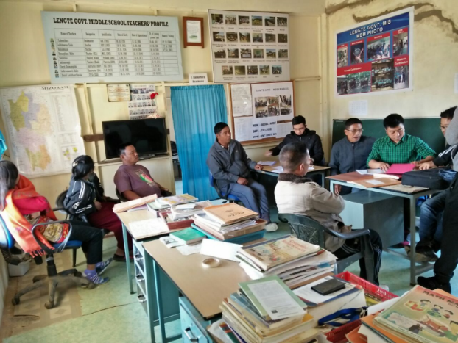
SOCIAL AUDIT
Social Audits were conducted in two Districts, namely, Kolasib and Mamit District by engaging SIRD & PR. 20 Schools each were covered in the two Districts.
The Report is under study.

Slide 9
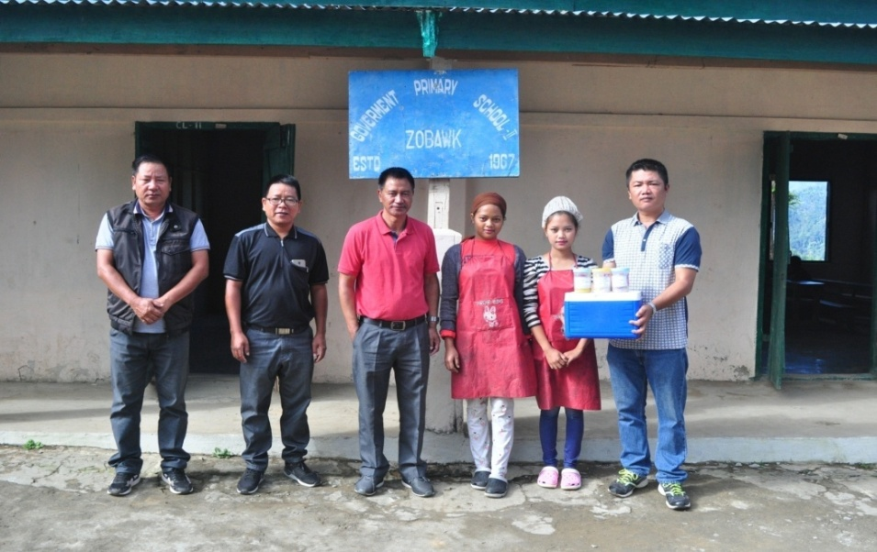
FOOD SAMPLE TESTING
Food Sample Testings were done at RIPANS during 2017-18. 32 Samples were tested so far in which only 8 samples are above norms.
Testing of Food Sample is done on regular basis. However due to heavy work load at RIPANS, the desired number could not be achieved.

Slide 10
COVERAGE UNDER RBSK (SCHOOL HEALTH) - 2017-18
Schools covered | Children covered | Health Check -ups carried out |  | Weekly Iron & Folic Acid Supplementation (WIFS) |  | Deworming tablets distributed |  | Distribution of spectacles
 |  | Schools | Children covered | Schools | Children covered | Schools | Children covered | No. of schools | No. of children covered
1 | 2 | 3 | 4 | 5 | 6 | 7 | 8 | 9 | 10
84% | 78% | 71% | 66% | 85% | 76% | 87% | 79% | 6 | 8
Source: School Health Programme, H&FW Dept

Slide 11
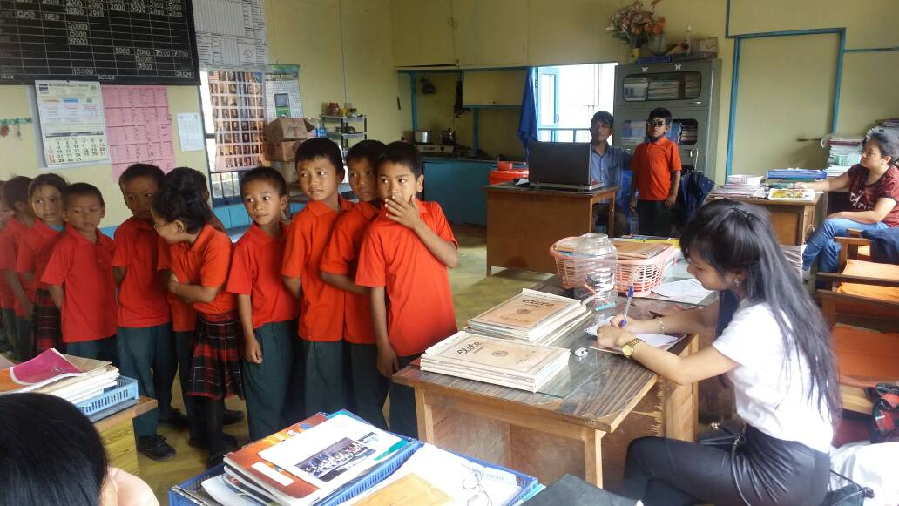
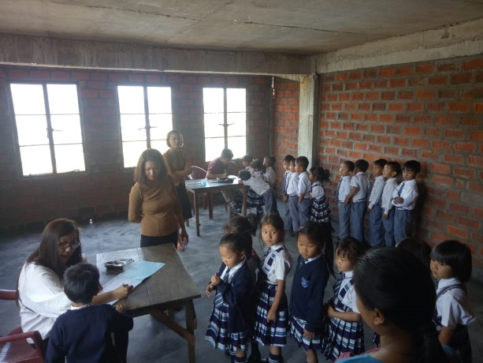
COVERAGE UNDER RBSK- HEALTH CHECK UP

Slide 12
Best Practices
State Government increases its contribution towards cooking cost for Upper Primary School (Cl-VI-VIII) to Re 1.00 per child per day from existing Re 0.70.) i.e. 18% as against the mandatory state matching share of 10%.
State Government’s contribution towards cooking cost for Primary School is Rs. 1.20, which is 32% as against the minimum mandatory state matching share of 10%.
The State Government continues to provide 40% against the Central provision of Rs 900/- per month for Honorarium to Cook-cum-Helper.

Slide 13
Best Practices
The State Government provided Rs. 667.35 lakh which is around one-fourth of the Annual requirement as Advance Allocation during 2017-18.
The State Government provide fund for Construction of 25 Kitchen shed and Dining Hall through RIDF under NABARD.

Slide 14
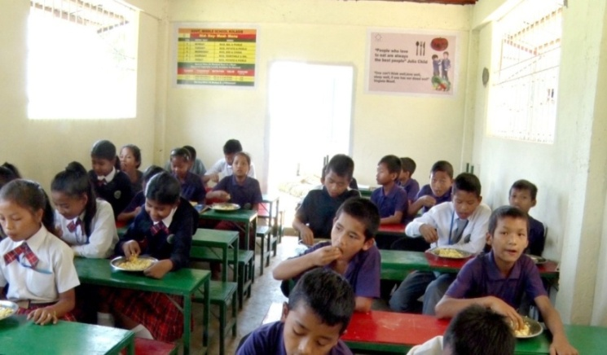
Construction of Dining Hall
Govt. Middle School, Kolasib constructed Dining Hall under MLA LAD Fund during 2017

Slide 15
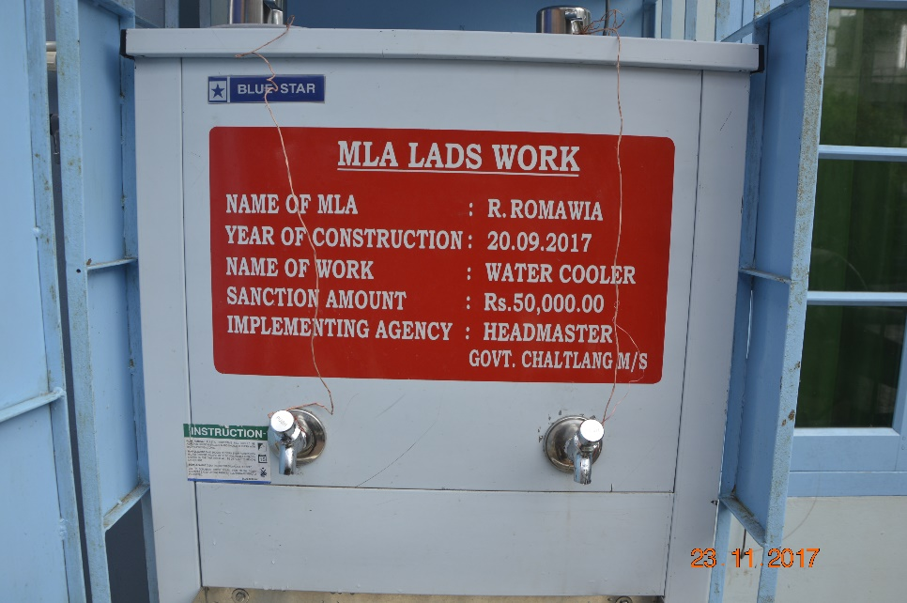
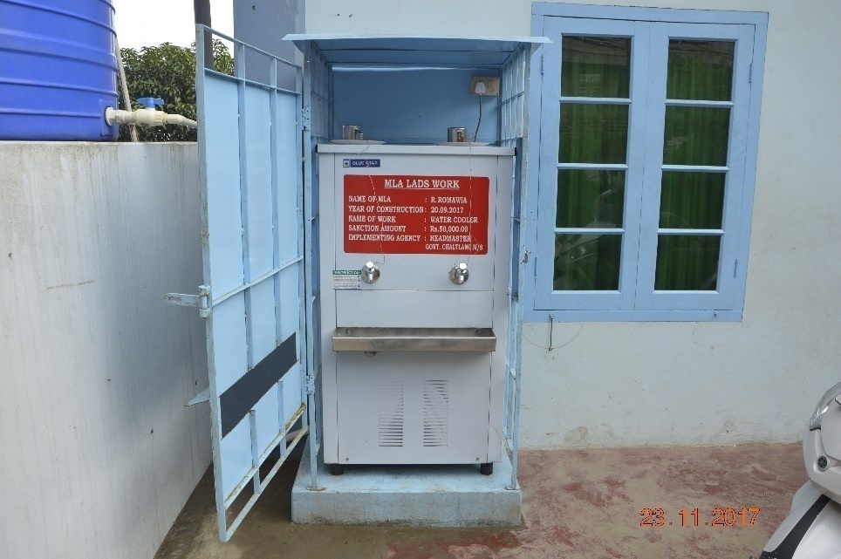
Safe Drinking Water Facility Under MLA LAD Fund
Govt. Chaltlang M/S is provided Safe Drinking Water Facility (Water Cooler) under MLA LAD Fund.

Slide 16
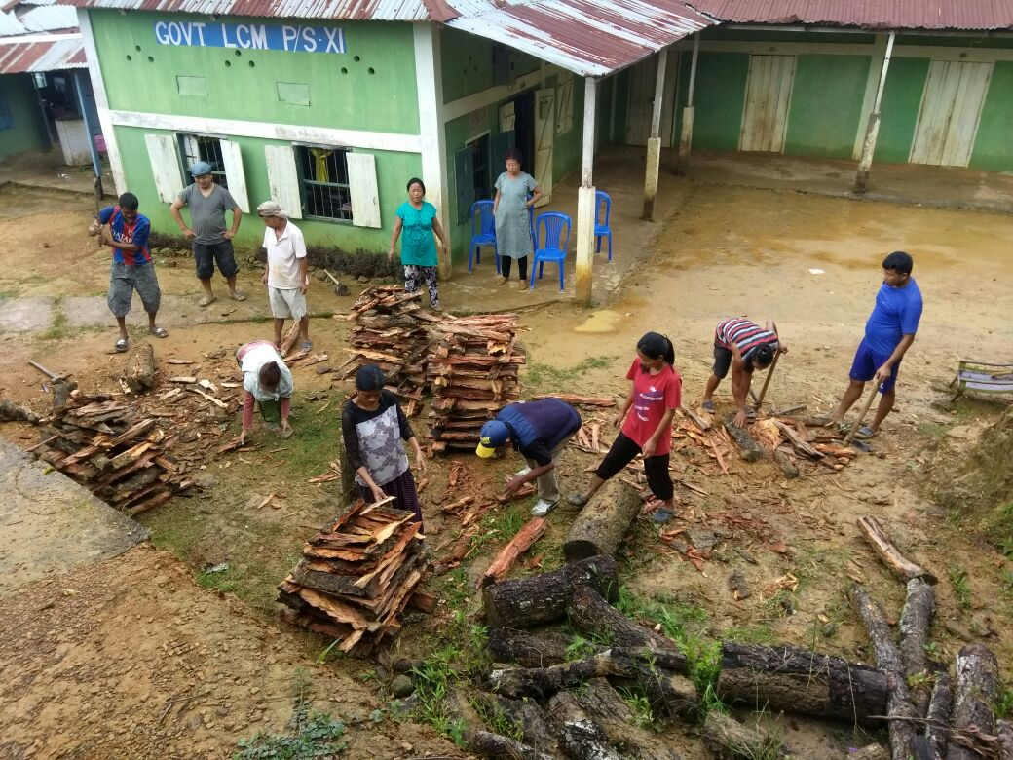
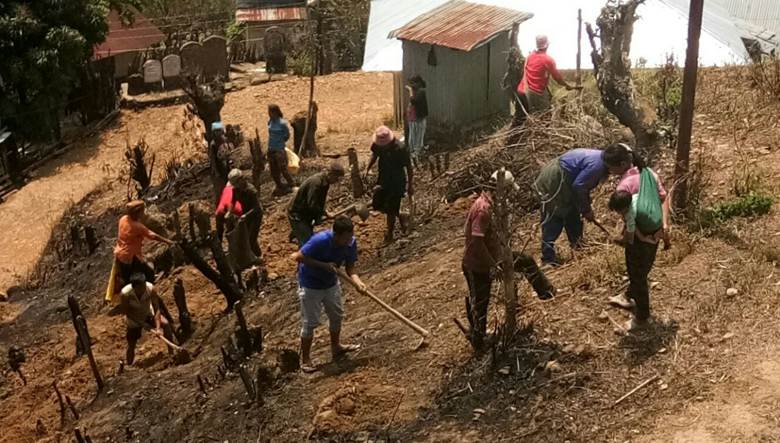
Community Participation
Community Participation is very good

Slide 17
Community Participation

Slide 18
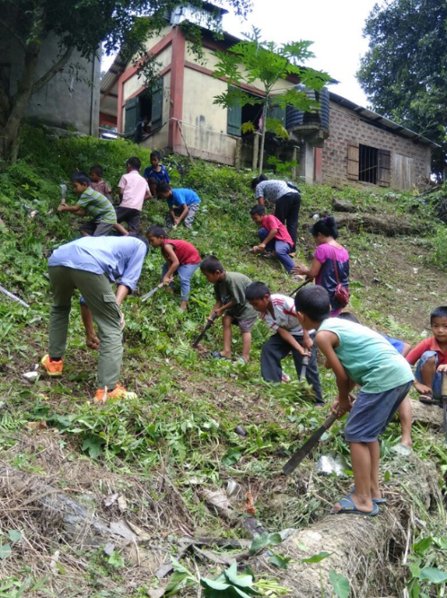
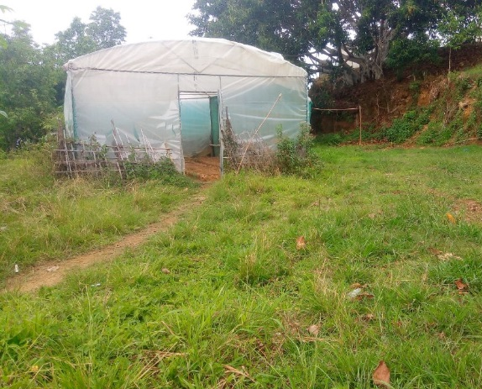
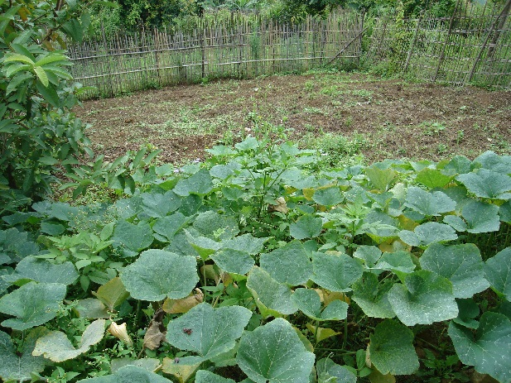
Kitchen Gardens in the State
Schools have been informed to develop Kitchen Garden wherever possible. Latest report shows that there are as many as 195 Nos. of Kitchen Gardens in schools at present.
There have been active community participations in preparation of lands for Kitchen Garden, contribution of seeds, etc.

Slide 19
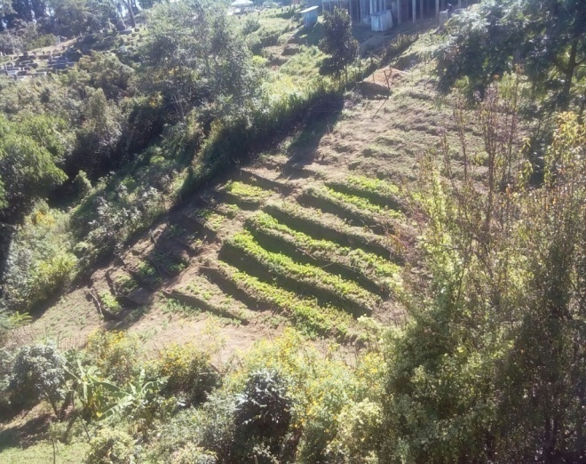
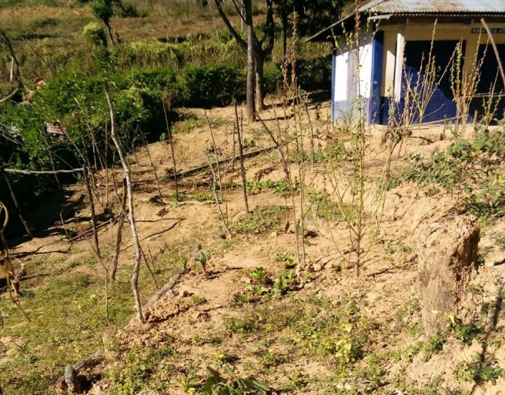
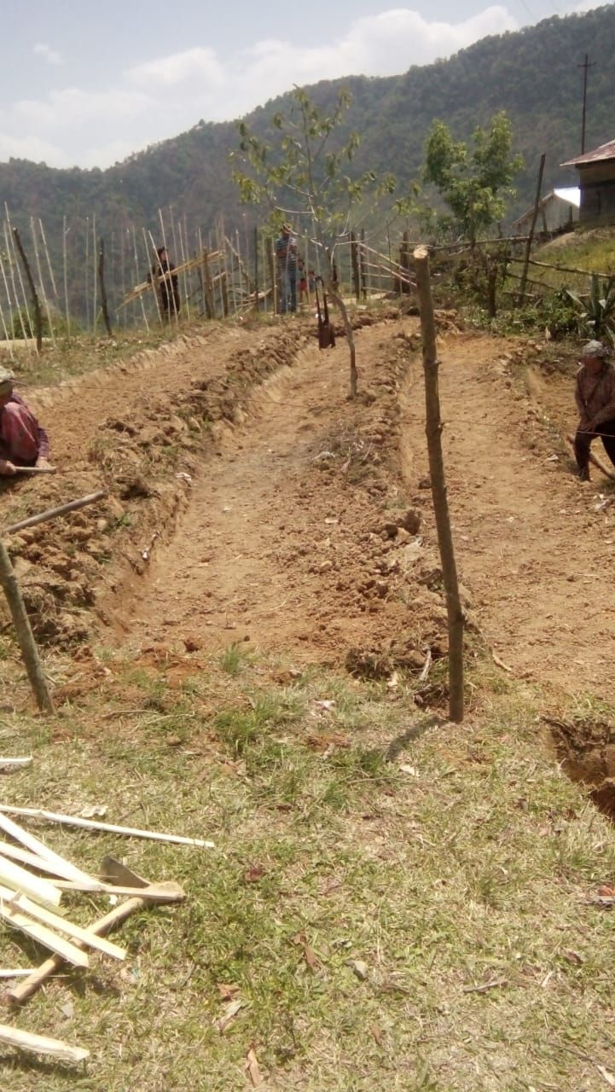
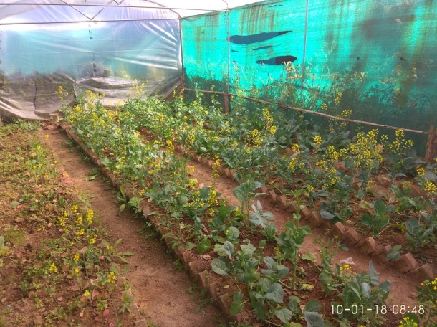
Kitchen Gardens in the State

Slide 20
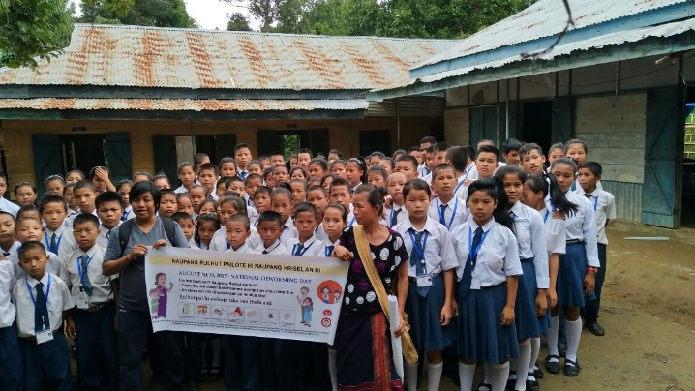
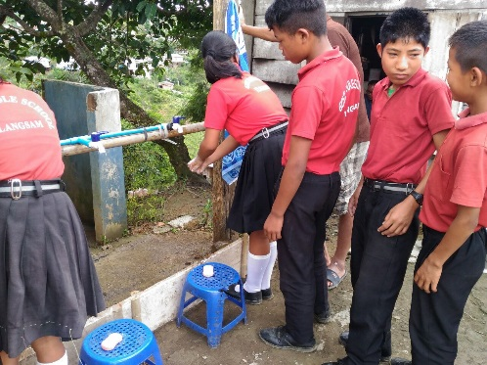
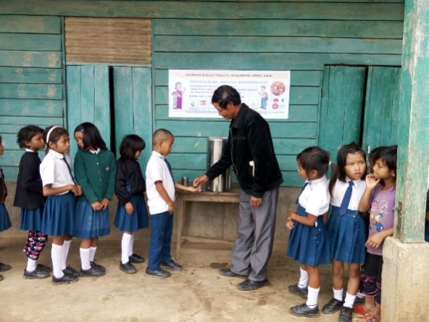
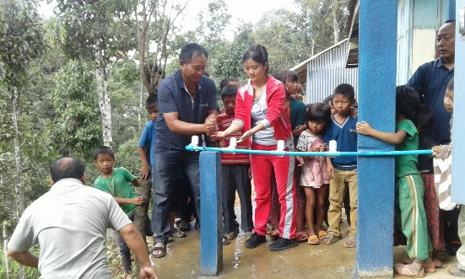
OBSERVANCE OF GLOBAL HAND WASHING DAY, NATIONAL DE-WORMING DAY & WORLD HEALTH DAY
World Health Day was observed in 7th April, 2017. Global Hand Washing Day and National Deworming Day were also observed on 16th October, 2017 and 17th August, 2017 in all Schools

Slide 21
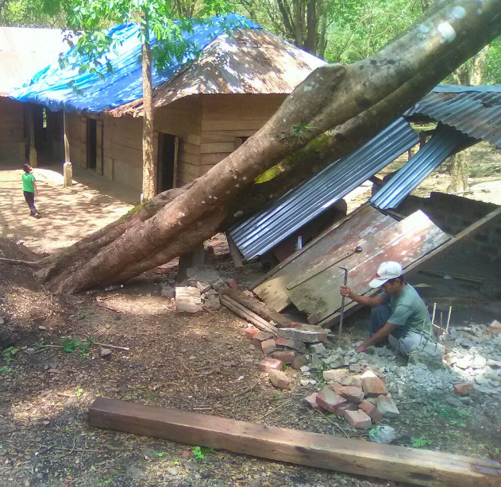
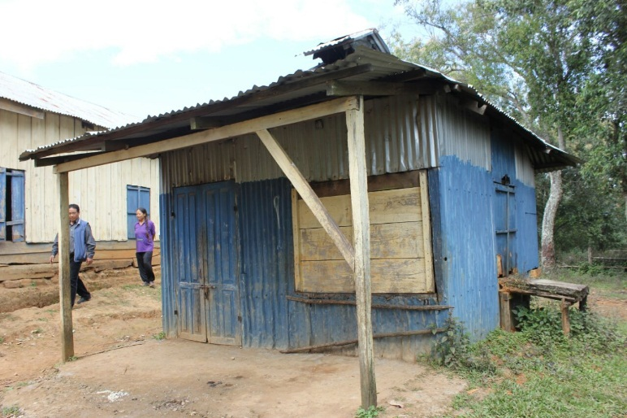
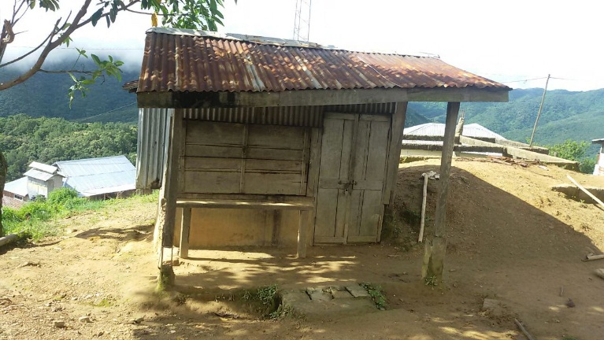
ISSUES
Many Kitchen Sheds in the State are in dilapidated condition. The Ministry is requested to provide funds for their reconstruction/repair and renovation.

Slide 22
PROPOSAL FOR 2018-19

Slide 23
Proposal for 2018-19
Sl.No | Component | PAB Approval for 2017-18 | Proposal for 2018-19
1 | Children (Primary) | 97,070 | 92,114
2 | Children ( Upper Primary) | 42,189 | 41,336
3 | Working Days (Primary) | 215 | 202
4 | Working Days (Upper Primary) | 220 | 212
5 | Cook-Cum-Helper | 5,220 | 5,220
6 | Kitchen-cum-Store | NIL | 26
7 | Kitchen Devices (Replacement) | NIL | 608

Slide 24
Thank you

